Slide 1
Hotel Management Software
Project outlines
Eduardo Lenzi
Patrick Tschuchnig

Slide 2
Planned General Design Architecture
n-Tier Approach divided into 2 separate softwares
Web UI interfacing with a Server application
Server Application divided into multiple parts
REST Interface, Middleware, Control Logic, Business Logic, Database Handling

Slide 3
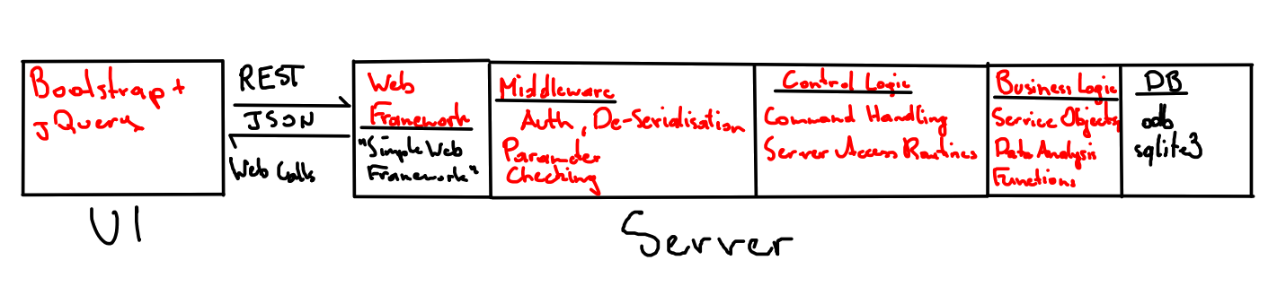
Planned General Design Architecture

Slide 4
Implementation Plan & Roadmap
ODB &
DB Routines
Control Logic
Functionality
Middleware
Development
Web Service
Functionality
Optional
Features
Frontend
Development

Slide 5
Milestones
Backend logic
programming,
DB routines,
Entities
Web Interfacing
in a working
condition
UI Layout
and Auth Layer

Slide 6
Frontend
Web Interface using Bootstrap and jQuery
Communication with the Server via REST API using JSON Objects
Multiple Workflow Pages
  Registration Page
  Customer Reservation Area
  Management Area

Slide 7
Server Backend
Web Services using “Simple Web Framework” for C++
In-House Middleware doing Authentication, JSON DeSerialisation and rudimentary sanity checks
Control Logic Routines for handling Commands from the UI and accessing Database Objects

Slide 8
Server Backend
Business Logic providing Service Objects, Data Analysis Routines
ORM Database Backend using odb and sqlite3¹
1: subject to change

Slide 9
Software Functionality
Customer Self-Registration and Room Reservation, with optional booking extras
Management Staff area allowing the control of reservations, managing guests and rooms
Data analysis functionality, i.e.:
  Map of the hotel showing room status
  Averages (Stay time, price, room load)
  Popular rooms for dynamic pricing

Slide 10
Optional Features
Customer Chat area
Guestbook area for reviews
Sane Error Handling routines
Other things we probably won’t have time for

Slide 11




Thank you for your attention

